Slide 1
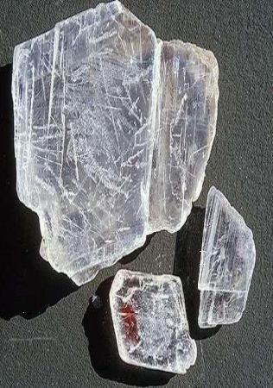
INTRODUCTION
Gypsum is a rock like mineral commonly found in the earth’s crust ,extracted, processed and used by Manin construction or decoration in the form of plaster andalabaster.
During the timeof the Pharaohs, Gypsum was used as mortar in the construction of the Cheops Pyramid (3000 B.C.).
Chemically it is CaSo4.2H2O i.e. Calcium Sulphate Dihydrate. Impurities: MgO, Al2O3, Fe2O3, SiO2,CaCO3, MgCO3

Slide 2
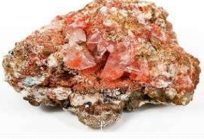
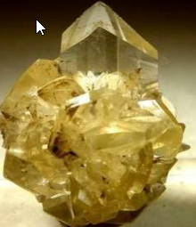
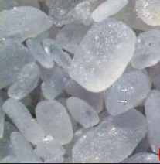
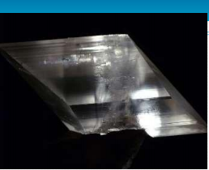
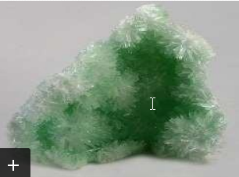
Colour- transparent towhite and can be of grey, green ,pink,blueand red because of impurities

Slide 3
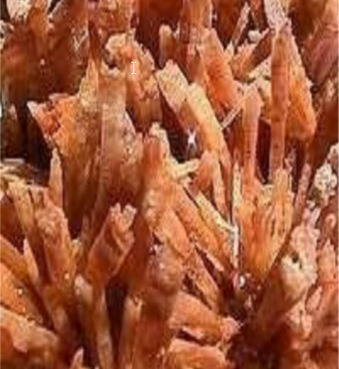
OCCURRENCE OF GYPSUM
A common mineral, with thick and extensive evaporite beds in association with sedimentary rocks.
Gypsum is deposited in lake and sea water.
Hydrothermal anhydrite in veins is commonly hydrated to gypsum by groundwater
in near surface exposures.
Often associated with the minerals halite and sulfur.

Slide 4
PRODUCTION STEPS
➢Excavating
➢Crushing (~25 mm
diameter)
➢Grinding
➢Heating (calcining)
➢Cooling and Pulverizing
➢Marketing in Bags

Slide 5
CALCINATION
Gypsum rock when heated to 100-190°C looses 3⁄4 of its watert CaSO4.2H2O → CaSO4.1⁄2H2O + 3/2 H2O Plaster of Paris
This is low burning process and named as INCOMPLETECALCINATION
When calcination is carried out at temperatures above190°C all water isremoved.CaSO4.2H2O → CaSO4 + 2H2Ogypsum anhydrite
This is high-burning process & COMPLETE CALCINATION.
Both of these products form gypsum rock by recombining with water.CaSO4.1⁄2H2O + 3/2H2O → CaSO4.2H2O CaSO4 + 2H2O →CaSO4.2H2O
Calcination process is carried out in two types of kilns.Kettle Kilns Rotary Kilns

Slide 6
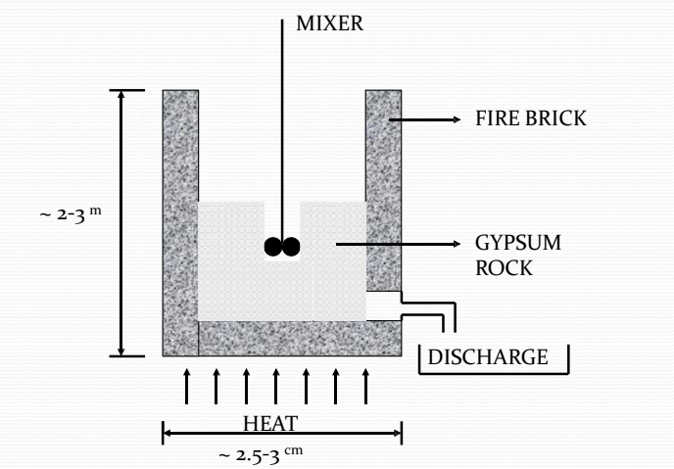
KETTLE KILN

Slide 7
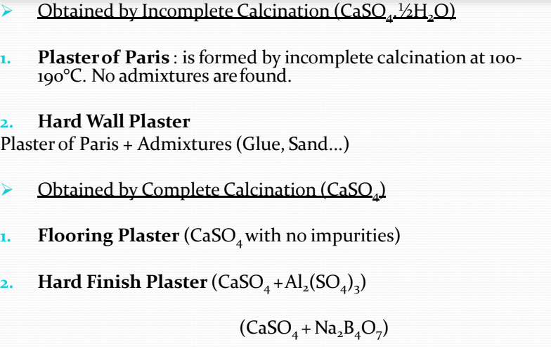
GYPSUM PLASTERS

Slide 8
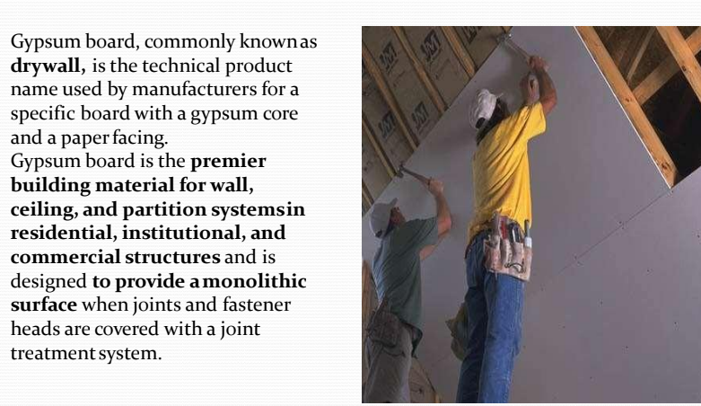
What is Gypsum Board?

Slide 9
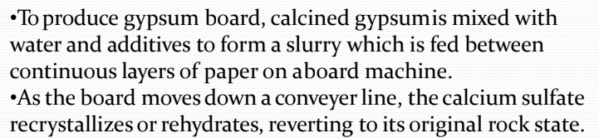
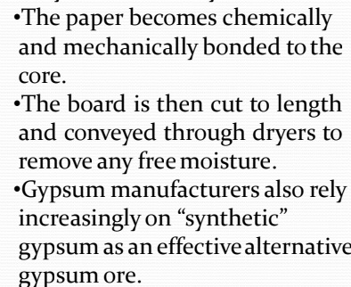
Making Gypsum Board

Slide 10
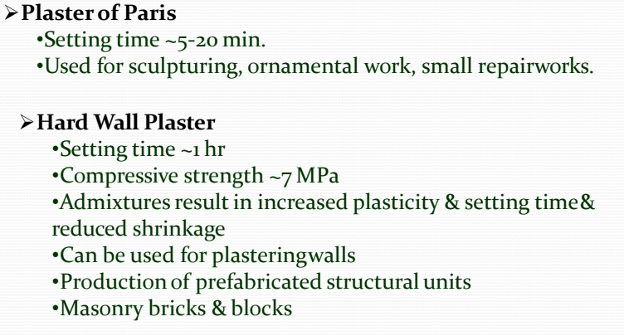
PROPERTIES AND USES OF GYPSUM PLASTERS

Slide 11
➢ Flooring, Hard Finish Plaster •Setting time ~1-16 hrs •Compressive strength > 7 MPa •Can be used for producing prefabricated units , masonry bricks & blocks & flooring & pavement bricks &tiles. ➢ Gypsum often serves as a fire proofing material even though its strength is destroyed by long continuous heat. It forms a powder covering the surface which acts as an effective insulator. ➢ Gypsum products tend to disintegrate when exposed to moisture. Therefore, they should not be used for exterior work & for moist interiors. (NON-HYDRAULIC)

Slide 12
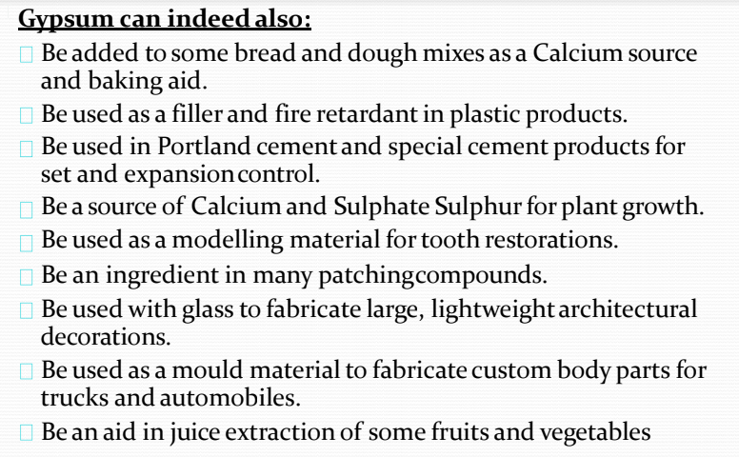
OTHER USES OF GYPSUM

Slide 13
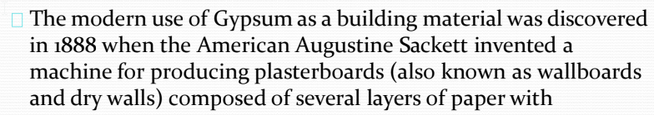
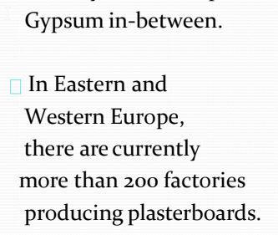
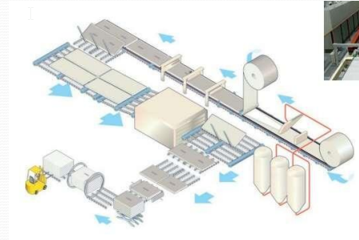
The Modern Use of Gypsum in Construction: Plasterboard

Slide 14
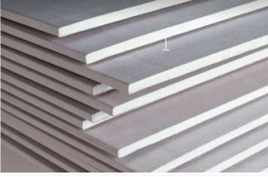
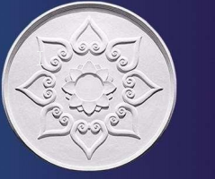
Uses of Gypsum Products in Home Interiors
➢ Plasterboards
•Plasterboard is used for partitions and the lining of walls, ceilings, roofs and floors. The properties
of plasterboard can be modified to meet specific requirements, such as fire resistance, humidity
resistance, impact resistanc etc.
➢ Decorative Plaster
•Plaster powder, mixed with water, manually or through the use of silo-supplied spray systems, is
used to create an effective and aesthetically-pleasing lining for brick and block walls, and for ceilings.
•Gypsum’s adaptability in application lends itself to moulding and shaping. Since time immemorial , Gypsum has been used by skilled craftsmen to create decorative
plaster mouldings.

Slide 15
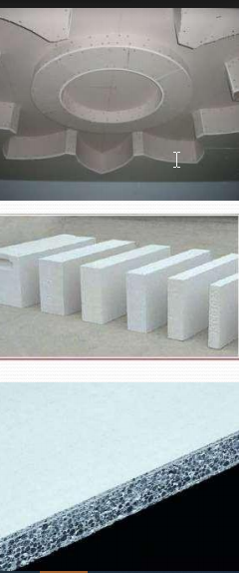
Building plaster • Gypsum plaster is used for wall sand ceilings. ➢ Plaster blocks •Gypsum blocks are used for partitions and Gypsum tiles for ceilings. ➢ Gypsum based self levelling screeds •Anhydrite or Alpha- Hemihydrates are used in the production of self levelling floor screeds. ➢Gypsum Fibre boards •Gypsum fibr board is used for partitions and lining of walls, ceilings, roofs and floors. Gypsum Fibre board offers good performance when it comes to impact resistance, sound insulation and humidity resistance. Gypsum Products

Slide 16
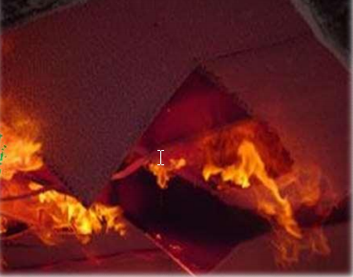
Gypsum Products Unique Properties
1) FIREPROPERTIES
•Due to the natural composition of Gypsum, gypsum plasterboards are inherently fire resistant.
•The chemical formulation of Gypsum is CaSO4.2H2O – Calcium Sulphate Dihydrate.
•In nature, Gypsum occurs in the form of crystals.
•The presence of water in Gypsum (H2O), one square meter of plasterboard of 15mm
thickness contains around 3 litre crystal water.
•Through the action of fire, the crystal water evaporatesand a protective layer
of Gypsum is formed.
•Behind this layer, the material under fire attack, remains at constant temperature
around 100oC as long as water is released from the Gypsum.

Slide 17
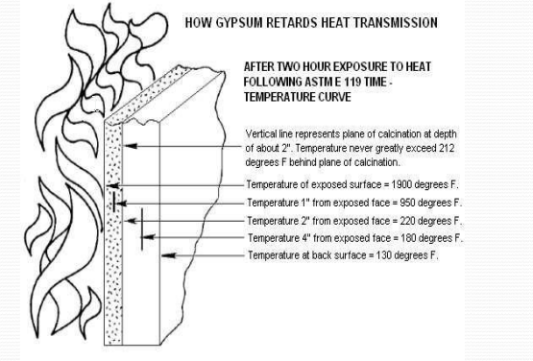
•The inclusion of glass fibres in Gypsum boards enhances their fire protection performance by maintaining the integrity of the board in a fire. •Gypsum is a powerful firer etardant element in the construction sector due to its non-combustibility and ability to delay for up to 4 hours - according to the number of plasterboards in the corresponding system - the progression of fire.

